Slide 1
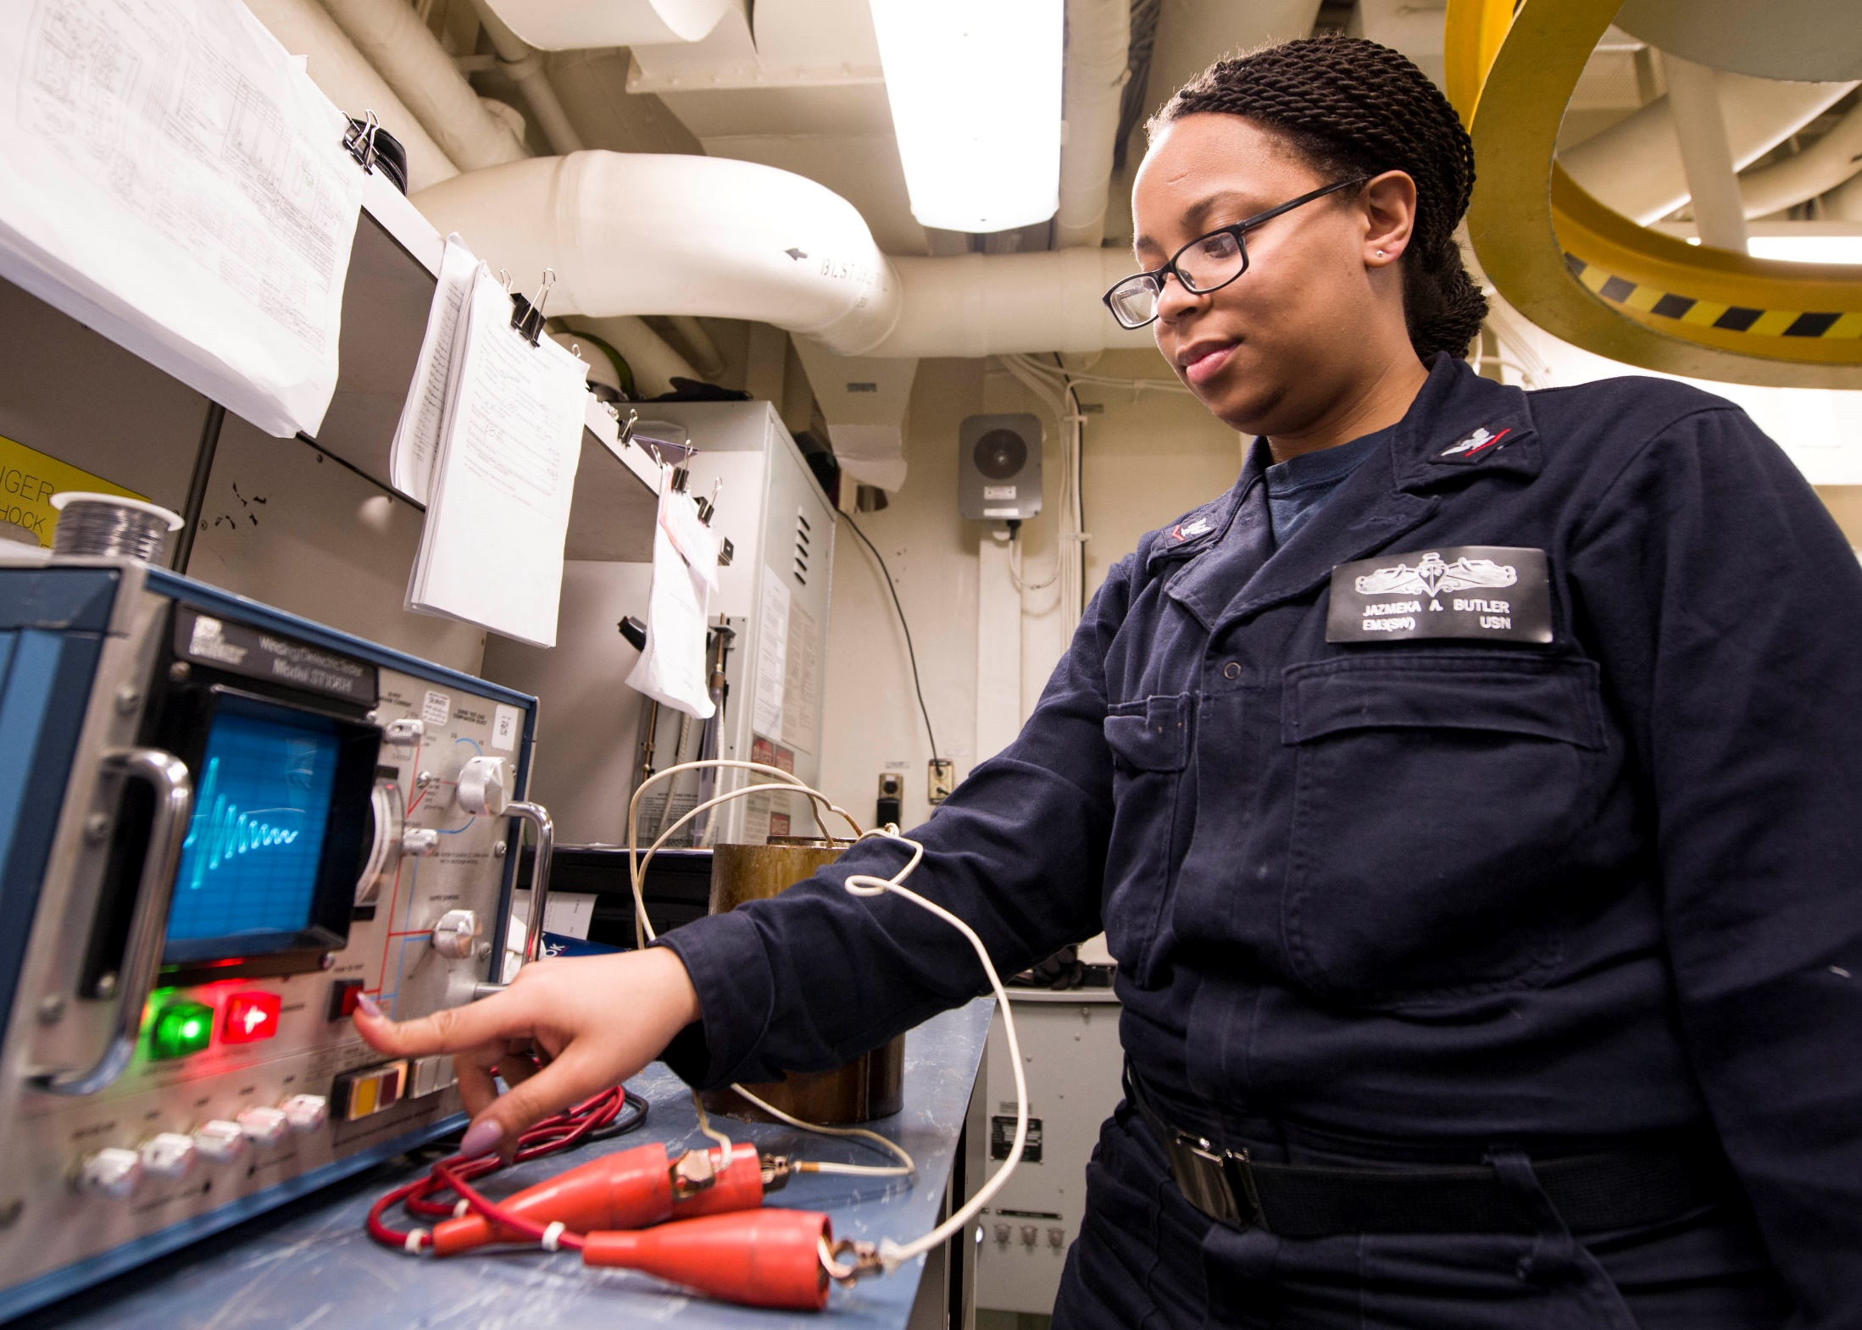
Electrical Troubleshooting
Electrical Troubleshooting by Ken Dickson-Self is licensed under a Creative Commons Attribution-ShareAlike 4.0 International License. Permissions beyond the scope of this license may be available at Linn Benton Community College.
"Electrician's Mate 3rd Class Jazmeka Butler conducts a surge test" by U.S. Navy photo by Kristina Young, Flickr, U.S. Pacific Fleet is in the Public Domain

Slide 2
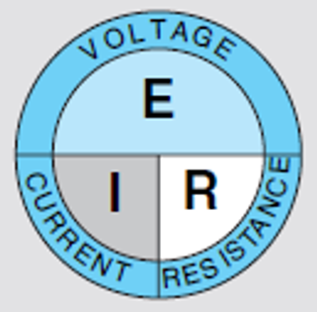
Voltage, Current and Resistance
Quantity | Symbol | Unit of Measure | Unit Abbreviation
Current | I | Ampere (Amp) | A
Voltage | E (or V) | Volt | V
Resistance | R | Ohm | Ω
Figuring out Power is as easy as PIE (P = IE)

Slide 3
Scientific Notation and Prefixes
Multiple | Prefix | Symbol |  | Multiple | Prefix | Symbol
10²⁴ | yotta | Y |  | 10⁻¹ | deci | d
10²¹ | zetta | Z |  | 10⁻² | centi | c
10¹⁸ | exa | E |  | 10⁻³ | milli | m
10¹⁵ | peta | P |  | 10⁻⁶ | micro | μ
10¹² | tera | T |  | 10⁻⁹ | nano | n
10⁹ | giga | G |  | 10⁻¹² | pico | p
10⁶ | mega | M |  | 10⁻¹⁵ | femto | f
10³ | kilo | k |  | 10⁻¹⁸ | atto | a
10² | hecto | h |  | 10⁻²¹ | zepto | z
10¹ | deka | d |  | 10⁻²⁴ | yocto | y

Slide 4
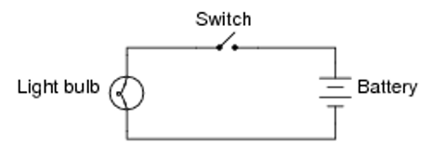
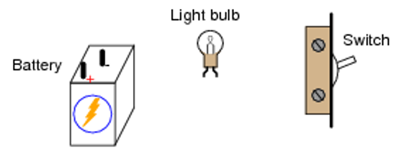
The “Check-off” Method
Given the following schematic diagram, show how the given components might be connected together with wires to form the circuit
Images: Tony Kuphaldt via allaboutcircuits.com, used under the Direct Science License.

Slide 5
Intro to DMM
Notes:
Here students are shown how to use a DMM for measuring resistance, voltage and current using a Fluke 179 meter.

Slide 6
Testing Fuses in a 3-Phase System
The Fused Disconnect Box
Measuring Line Voltage
Testing Fuses (Volts)
Testing Fuses (Ohms)
What is a fuse?
Notes:
What is a fuse?
How do we measure voltage DC? Single-phase AC?

Slide 7
Testing Fuses (Ohms)
To test the resistance of a fuse, it must first be removed from the system using a fuse puller.
A good fuse will have very little resistance
A bad fuse will have very high (or infinite) resistance

Slide 8
Testing Fuses In a 3-Phase System

Slide 9
Step 1 – The 3-phase Fused Disconnect Box
Typical source for branch circuits in a facility or building
Before starting: don proper PPE
Inspect box for damage prior to opening

Slide 10
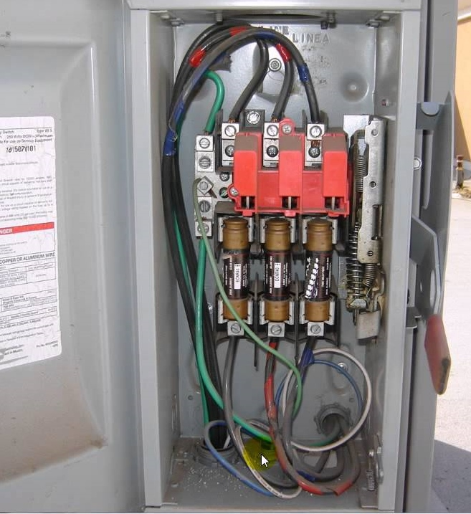
Step 1 – The 3-phase Fused Disconnect Box
Line Side – L1, L2, L3
Handle (far right) disconnects the circuits on the load side
Fuses protect these circuits
Disconnecting the circuits using the lever DOES NOT shut off power on the line side
Visually inspect for arcing or burning
Fuses
Load Side
Image created by Ken Dickson-Self. CC BY-SA 4.0

Slide 11
Step 2 - Measuring Line Voltage
Our first step will be to ensure we have voltage on the line side of the panel.
Line Side
L1
L2
L3
A
B
C
Load Side
Meter
0.0 VAC
Image created by Ken Dickson-Self. CC BY-SA 4.0

Slide 12
Step 2 - Measuring Line Voltage
Line Side
Our first step will be to ensure we have voltage on the line side of the panel.
First measure the voltage from L1 to L2
A good (normal) reading would be 208 +/- 3% VAC (or 202 – 214 VAC). Actual readings will vary.
L1
L2
L3
A
B
C
Load Side
Meter
208 VAC
Image created by Ken Dickson-Self. CC BY-SA 4.0
Notes:
Knowing what you already know about fuses, if I were to pull Fuse A from the system, set it on a bench and measure its resistance, what reading (in Ohms) should I expect from a good fuse? From a bad one?
How will the DMM be set?

Slide 13
Step 2 - Measuring Line Voltage
Line Side
Our first step will be to ensure we have voltage on the line side of the panel.
First measure the voltage from L1 to L2
Next, measure from L1 to L3
L1
L2
L3
A
B
C
Load Side
Meter
208 VAC
Image created by Ken Dickson-Self. CC BY-SA 4.0
Notes:
Knowing what you already know about fuses, if I were to pull Fuse A from the system, set it on a bench and measure its resistance, what reading (in Ohms) should I expect from a good fuse? From a bad one?
How will the DMM be set?

Slide 14
Step 2 - Measuring Line Voltage
Line Side
Our first step will be to ensure we have voltage on the line side of the panel.
First measure the voltage from L1 to L2
Next, measure from L1 to L3
Last, measure from L2 to L3
If all three voltages are within the expected range, turn the fused disconnect ON to prepare for the next step.
L1
L2
L3
A
B
C
Load Side
Meter
208 VAC
Image created by Ken Dickson-Self. CC BY-SA 4.0
Notes:
Knowing what you already know about fuses, if I were to pull Fuse A from the system, set it on a bench and measure its resistance, what reading (in Ohms) should I expect from a good fuse? From a bad one?
How will the DMM be set?

Slide 15
Step 3 – Testing Fuses (Volts)
First measure the voltage from the line side of L1 to the load side of L2
Line Side
L1
L2
L3
A
B
C
Load Side
Meter
208 VAC
Image created by Ken Dickson-Self. CC BY-SA 4.0
Notes:
Knowing what you already know about fuses, if I were to pull Fuse A from the system, set it on a bench and measure its resistance, what reading (in Ohms) should I expect from a good fuse? From a bad one?

Slide 16
Step 3 – Testing Fuses (Volts)
First measure the voltage from the line side of L1 to the load side of L2
Next, measure the voltage from the line side of L1 to the load side of L3
Line Side
L1
L2
L3
A
B
C
Load Side
Meter
208 VAC
Image created by Ken Dickson-Self. CC BY-SA 4.0

Slide 17
Step 3 – Testing Fuses (Volts)
First measure from the line side of L1 to the load side of L2
Next, measure from the line side of L1 to the load side of L3
Last, measure from the line side of L3 to the load side of L1
If the fuses are all good, the voltages should match what you measured on the line side measurements in Step 2.
Line Side
Line Side
L1
L2
L3
A
B
C
Load Side
Load Side
Meter
208 VAC
Image created by Ken Dickson-Self. CC BY-SA 4.0
Notes:
Knowing what you already know about fuses, if I were to pull Fuse A from the system, set it on a bench and measure its resistance, what reading (in Ohms) should I expect from a good fuse? From a bad one?

Slide 18
Step 3 – Testing Fuses (Volts)
Measure the voltage from L1 to L2
This tests Fuse B
Measure from L1 to L3
This tests Fuse C
Last, measure from L3 to L1
This tests Fuse A
** A bad/blown fuse will cause sensitive DMMs to measure an unexpected (non-zero or “ghost”) voltage. Older DMMs may register 0V.
Line Side
L1
L2
L3
A
B
C
Load Side
Meter
34.7 VAC
Image created by Ken Dickson-Self. CC BY-SA 4.0
Notes:
Knowing what you already know about fuses, if I were to pull Fuse A from the system, set it on a bench and measure its resistance, what reading (in Ohms) should I expect from a good fuse? From a bad one?

Slide 19
Need to add something about gauge and wire sizes

Slide 20
Begin Lab 1
Notes:
What parts of this are still a little unclear or confusing for you?

