Slide 1
Attribution 4.0 International (CC BY 4.0)

Slide 2
Attribution 4.0 International (CC BY 4.0)

Slide 3
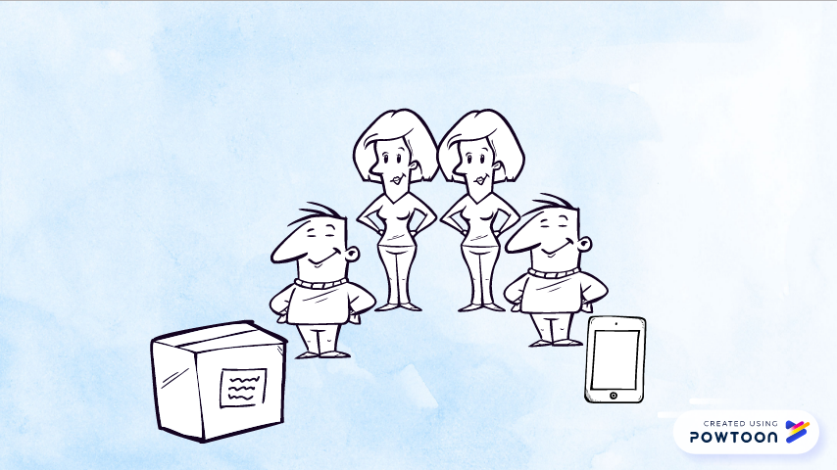
Attribution 4.0 International (CC BY 4.0)

Slide 4
Attribution 4.0 International (CC BY 4.0)

Slide 5
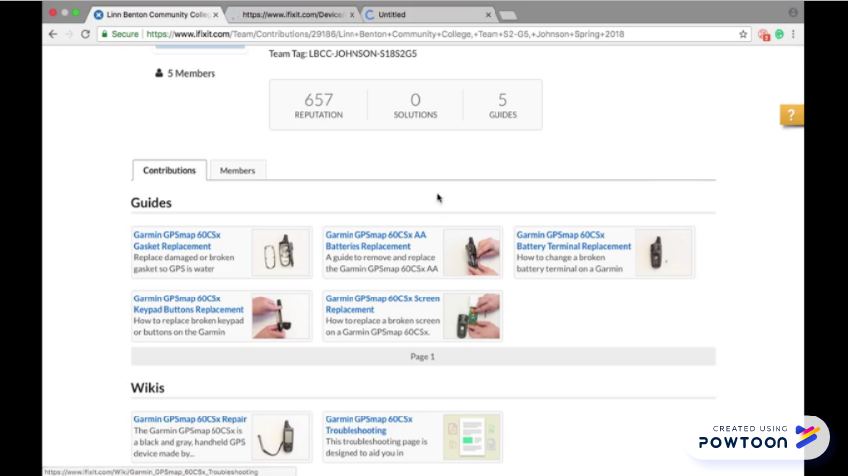
Attribution 4.0 International (CC BY 4.0)

Slide 6
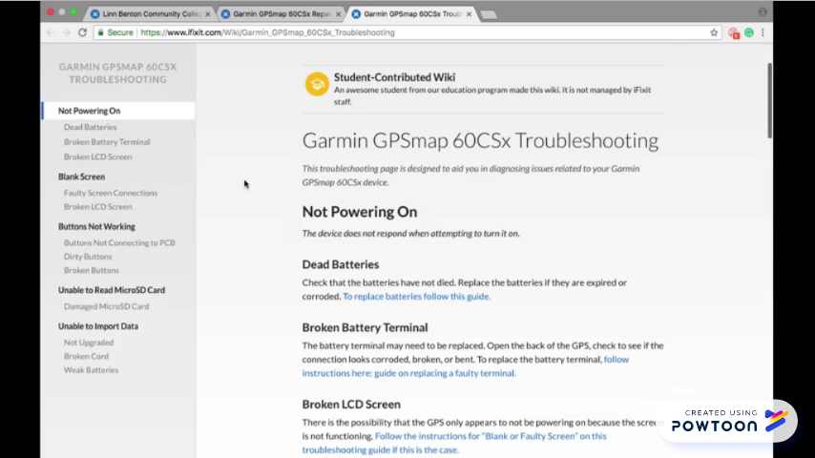
Attribution 4.0 International (CC BY 4.0)

Slide 7
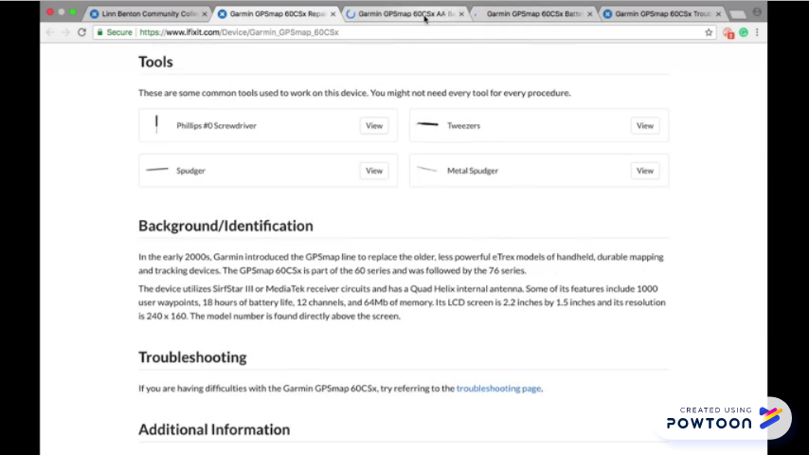
Attribution 4.0 International (CC BY 4.0)

Slide 8
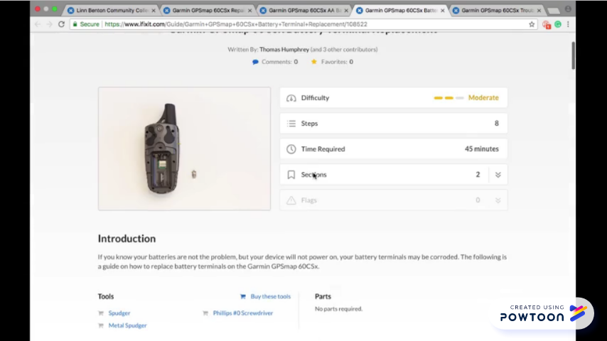
Attribution 4.0 International (CC BY 4.0)

Slide 9
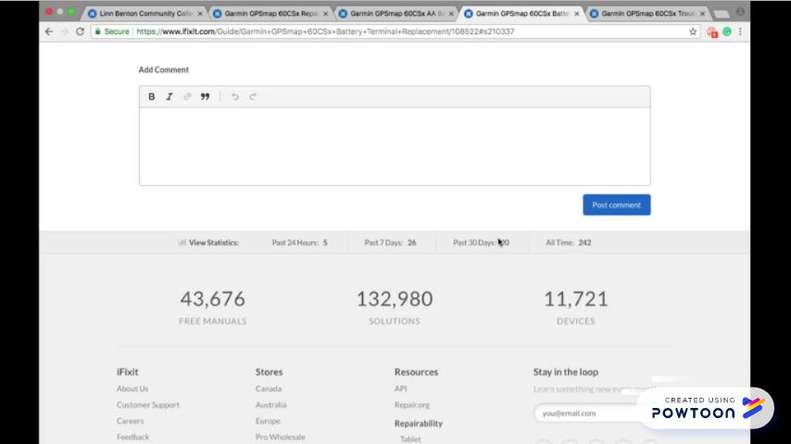
Attribution 4.0 International (CC BY 4.0)

Slide 10
Attribution 4.0 International (CC BY 4.0)

Slide 11
Attribution 4.0 International (CC BY 4.0)

Slide 12
Attribution 4.0 International (CC BY 4.0)

Slide 13
Attribution 4.0 International (CC BY 4.0)

